Slide 1
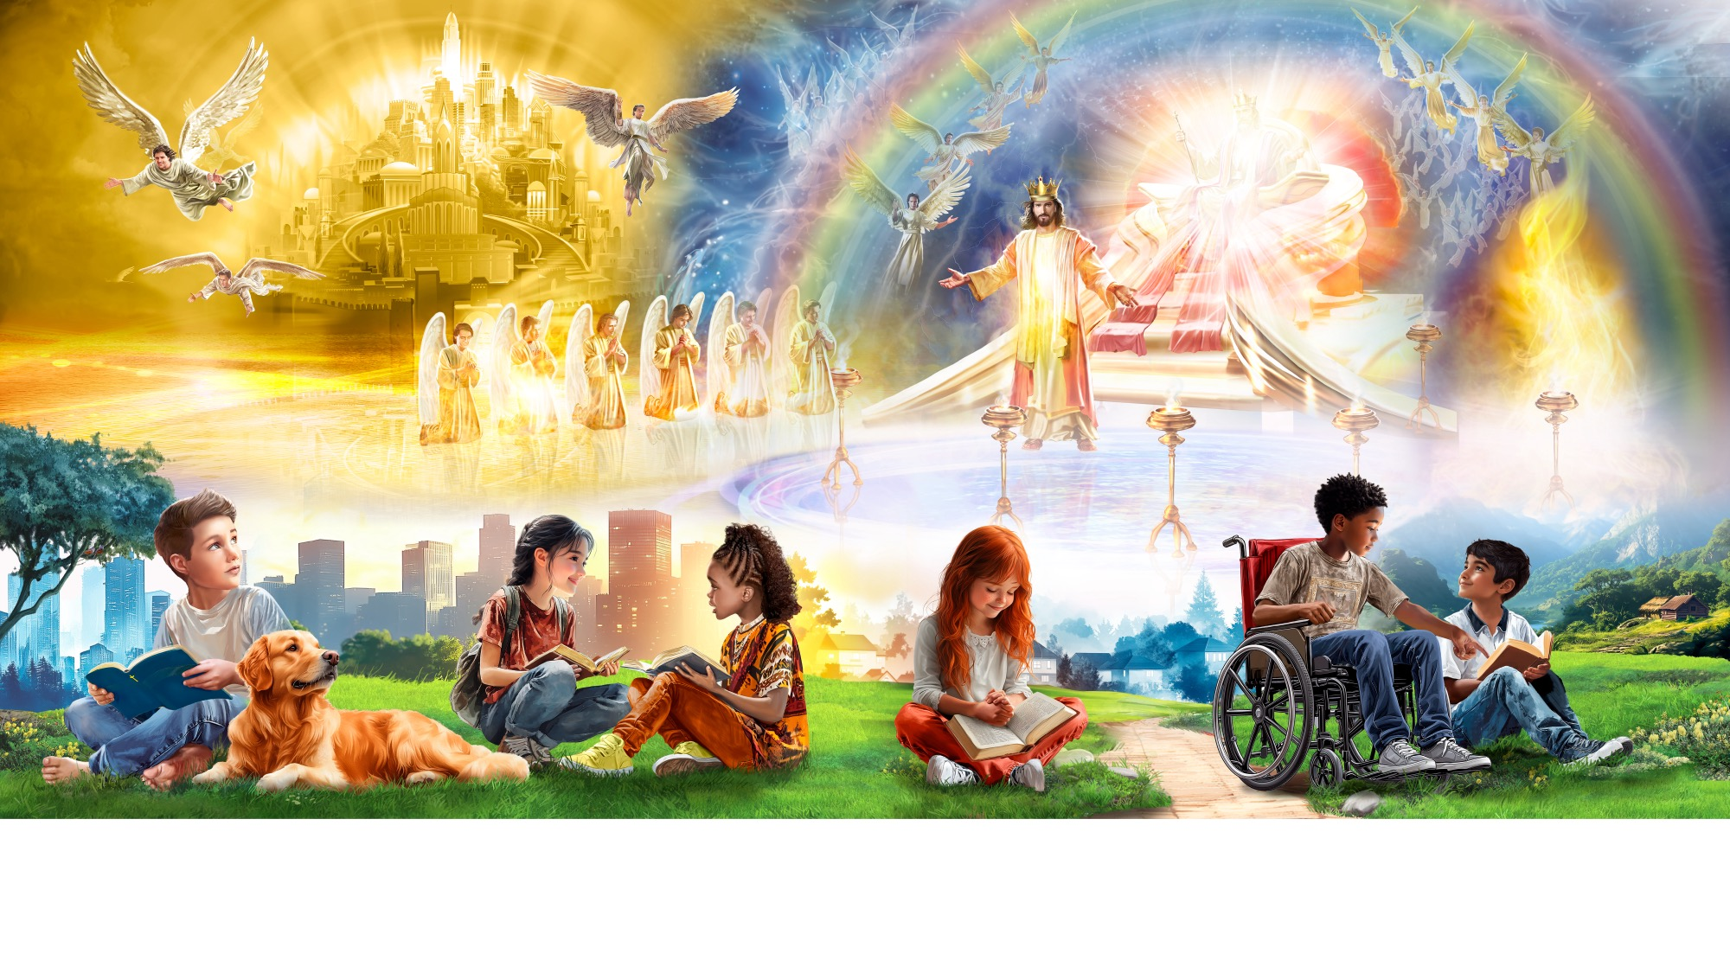
Welcome to Sabbath School

Slide 2
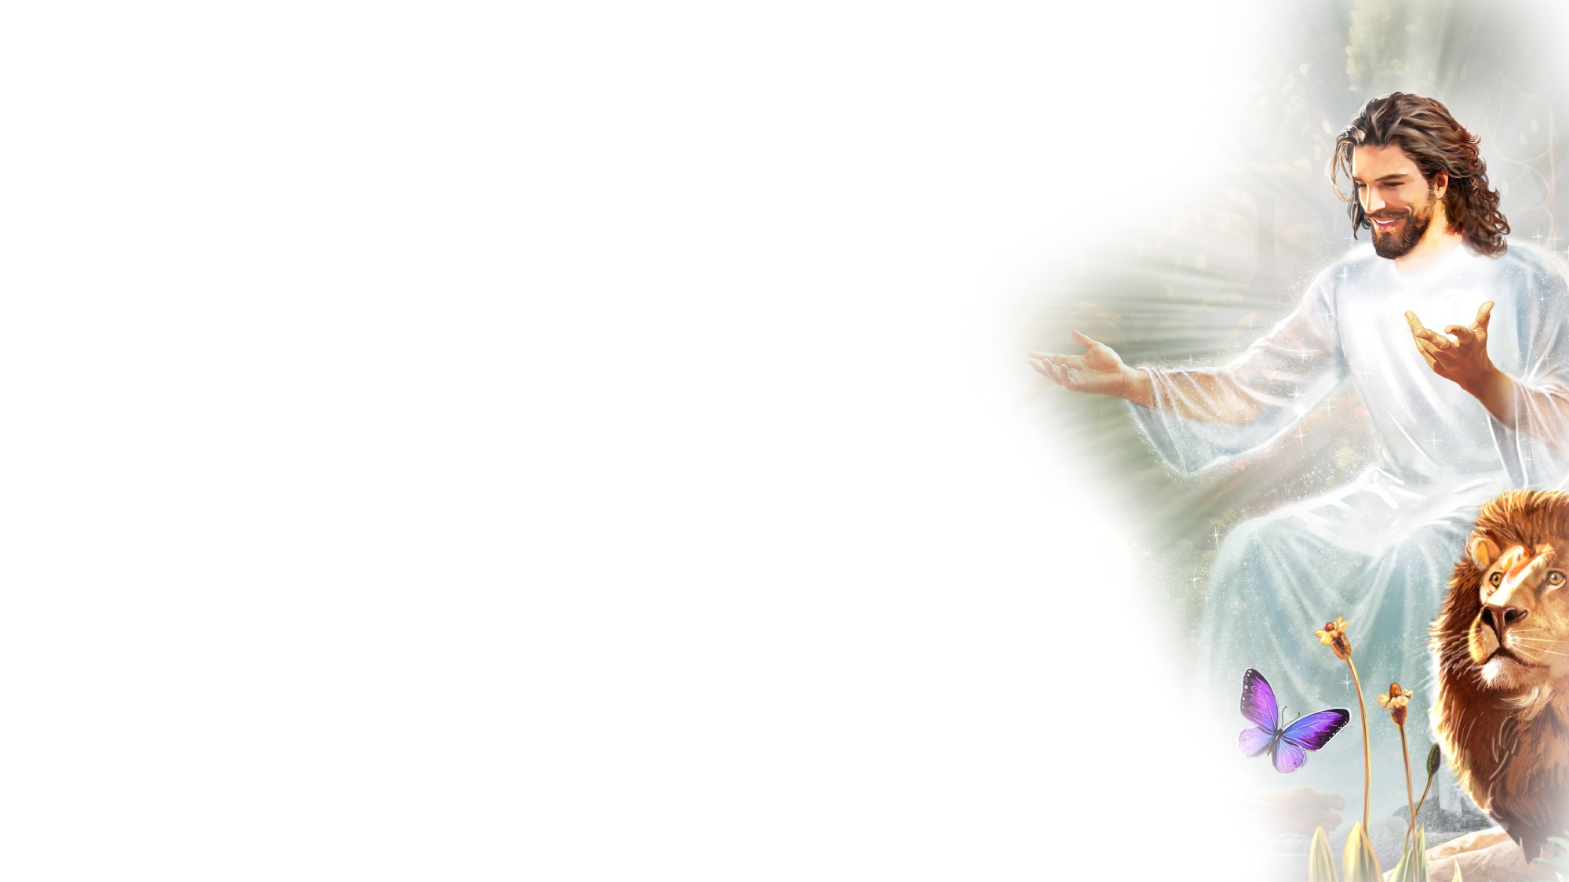
EARLY ARRIVALS
EARLY
ARRIVALS

Slide 3

When God Speaks
EARLY ARRIVALS
When God spoke
To the darkness,
“Let there be light,”
It was done,
And the darkness fled away.
When God spoke
To an old man,
“You’ll have a son,”
It was done,
And the sadness fled away.
When God speaks,
A miracle happens.
When God speaks,
The light begins to shine.
If God’s word is so powerful
That it can make the universe,
It can remake you, too.
When God spoke
To a blind man,
“Receive your sight,”
It was done,
And the darkness fled away.
When God spoke
To a dead man,
“Lazarus, come forth,”
It was done,
And the sadness fled away.
When God speaks,
A miracle happens.
When God speaks,
The light begins to shine.
If God’s word is so powerful
That it can make the universe,
It can remake you, too.
When God keeps His word,
Never will He fail.
In every command
And every promise,
There is power
To do what it says
For all who believe.
So, trust and obey,
Oh, trust Him today!
When God speaks,
A miracle happens.
When God speaks,
The light begins to shine.
If God’s word is so powerful
That it can make the universe,
It can remake you, too.
“When God Speaks” by Braeden Entermann. Copyright © Braeden Entermann. Arrangement copyright © 2025 General Conference Corporation® of Seventh-day Adventists.

Slide 4
Welcome to Sabbath School

Slide 5
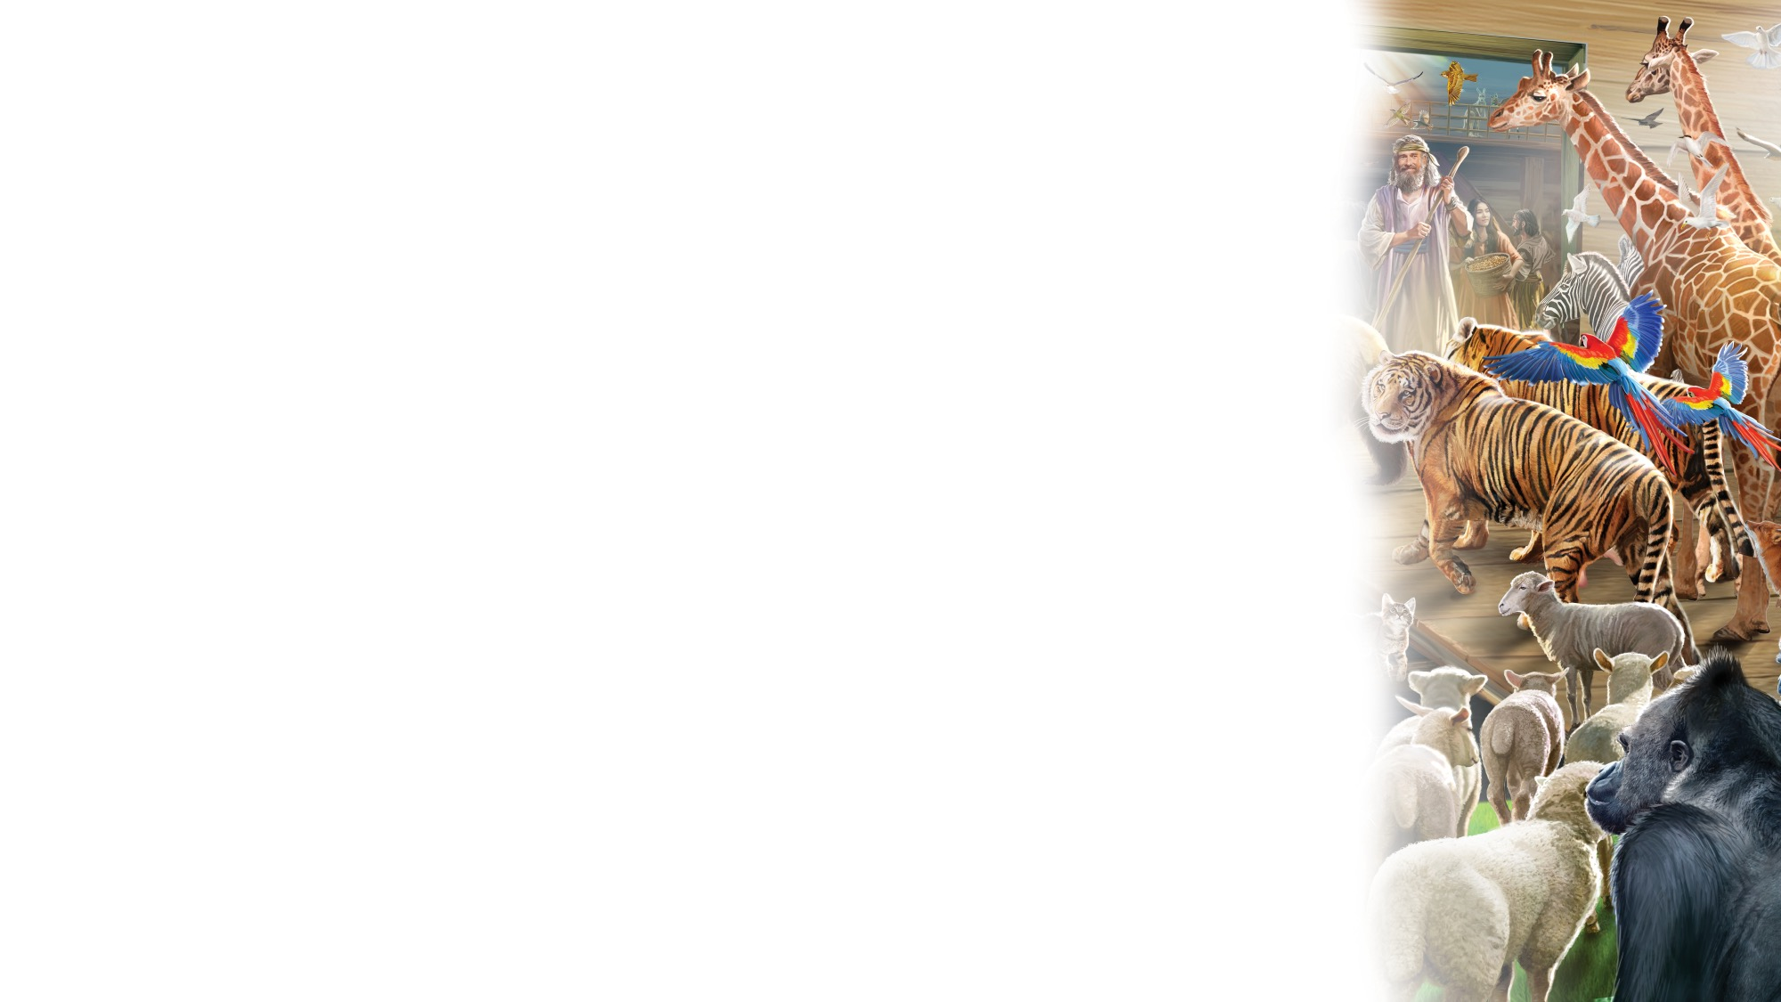
God Is Our Creator
OPENING ACTIVITIES
God made the light,
And the stars and the moon.
He made the sky and the sea.
God made the trees and the animals, too,
And He made you and me.
God is our Creator.
Nature declares our Father’s care.
There is no one greater than our God.
(Repeat above)
“God Is Our Creator” by Rosie Smith. Copyright © 2024 General Conference Corporation® of Seventh-day Adventists.

Slide 6
Be still, Be Silent
OPENING ACTIVITIES
Be still, be silent as we talk
To the King of kings.
He knows and hears you;
You can tell Jesus anything.
(Repeat above)
Let’s close our eyes,
And kneel before our King.
Amen.
“Be Still, Be Silent” by Rosie Smith. Copyright © 2024 General Conference Corporation® of Seventh-day Adventists.

Slide 7
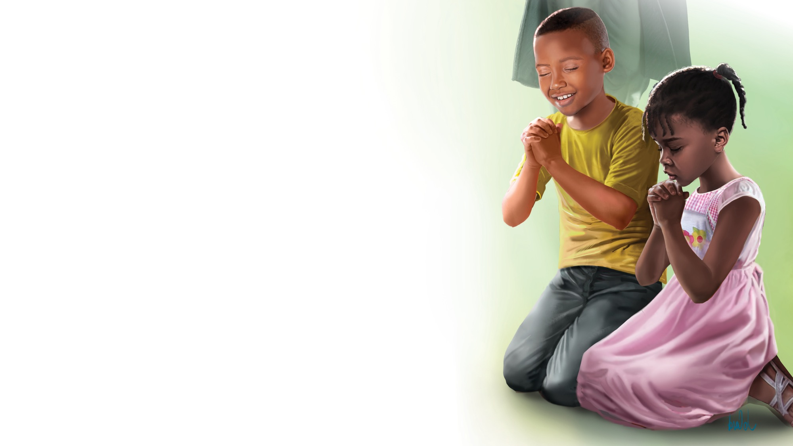
PRAYER
PRAYER

Slide 8


The Books of the Bible
BIBLE FOCUS
Let’s sing the books of the Bible.
Can you name all sixty-six?
Let’s sing the books of the Bible.
Sing with me, it goes like this…
Genesis, Exodus,
Leviticus, and Numbers,
Deuteronomy, Joshua,
Judges, and Ruth.
(Continued on next slide.)

Slide 9
The Books of the Bible
BIBLE FOCUS
First and Second Samuel,
First and Second Kings,
First and Second Chronicles,
Ezra, Nehemiah.
Esther, Job, and Psalms,
Proverbs, Ecclesiastes,
Song of Solomon,
Isaiah, Jeremiah.
(Continued on next slide.)

Slide 10
The Books of the Bible
BIBLE FOCUS
Lamentations, Ezekiel,
Daniel, Hosea,
Joel, and Amos,
Obadiah, and Jonah.
Micah, Nahum, Habakkuk, Zephaniah, and Haggai,
Zechariah, and Malachi.
We’ve just sung the first thirty-nine!
(Continued on next slide.)

Slide 11
The Books of the Bible
BIBLE FOCUS
Are you ready for the New Testament? Are you ready for the New Testament?
Matthew, Mark,
Luke, and John,
Acts, and Romans,
First and Second Corinthians,
Galatians, Ephesians,
Philippians, and Colossians,
(Continued on next slide.)

Slide 12
The Books of the Bible
BIBLE FOCUS
First and Second Thessalonians,
First and Second Timothy,
Titus, and Philemon.
Hebrews, and James,
First and Second Peter,
First, Second, and Third John,
Jude, and Revelation.
That’s twenty-seven more
And now we’re DONE!
“Books of the Bible” by Rosie Smith. Copyright © 2025 General Conference Corporation® of Seventh-day Adventists.

Slide 13
BIBLE FOCUS
BIBLE
FAST FACT

Slide 14
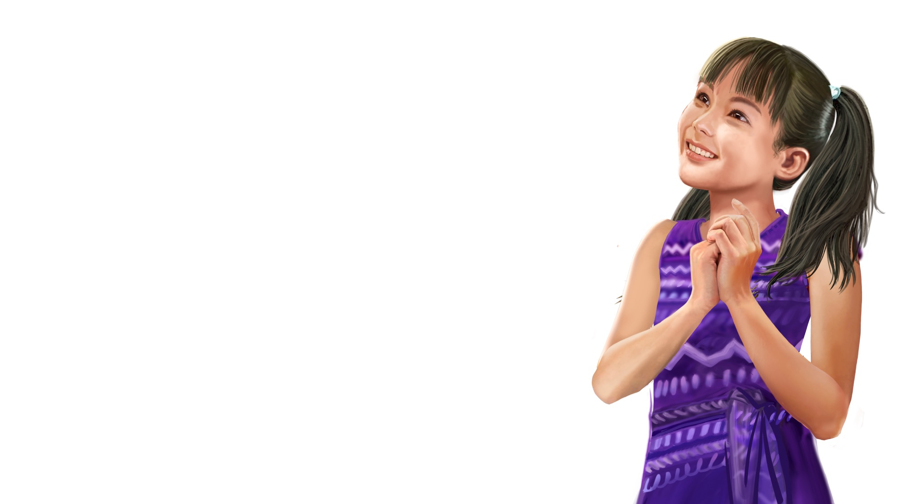
Thank You, Jesus
OFFERING
Thank you, Jesus,
For providing all my needs.
I want to give a little back
Of what you’ve given me.
Please bless our
Sabbath School offering.
May it bring You glory
And help others in need.
(Repeat above)
May it bring You glory
And help others in need.
“Thank You, Jesus” by Rosie Smith. Copyright © 2024 General Conference Corporation® of Seventh-day Adventists.

Slide 15
OFFERING
CHART &
MISSION
FAST FACT

Slide 16
Visitor Song
OPENING ACTIVITIES
We have a new friend
With us today.
We have a new friend.
Let’s smile and wave.
We welcome you to Sabbath School.
We’re glad you came.
We welcome you,
And hope to see you again. (x2)
“Visitor Song” by Rosie Smith. Copyright © 2024 General Conference Corporation® of Seventh-day Adventists.

Slide 17
Happy Birthday
OPENING ACTIVITIES
Happy birthday, happy birthday,
Happy birthday to you.
Jesus loves you dear ___________.
Happy birthday to you.
(Repeat above)
“Happy Birthday” by Janet Sage, copyright © 2001 North American Division Corporation of Seventh-day Adventists. From Little Voices Praise Him, #39. Used by permission.

Slide 18
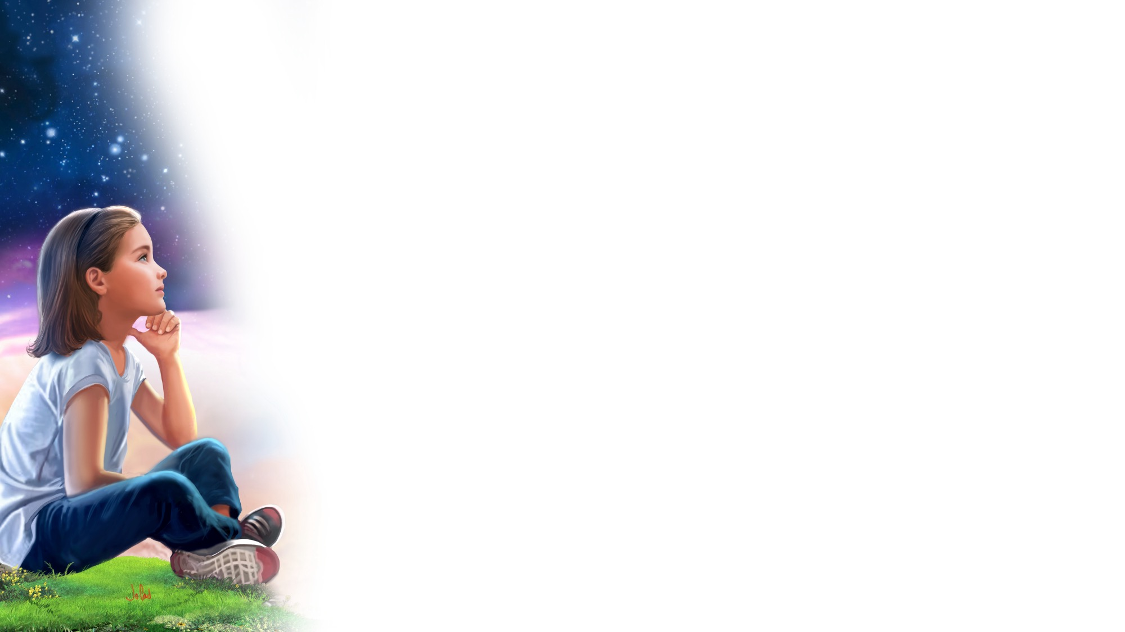
FOCUS
ACTIVITIES

Slide 19
BIG IDEA
God gave us
the Sabbath,
a very special day
to spend with Him.

Slide 20

BIBLE
STORY

Slide 21


Slide 22
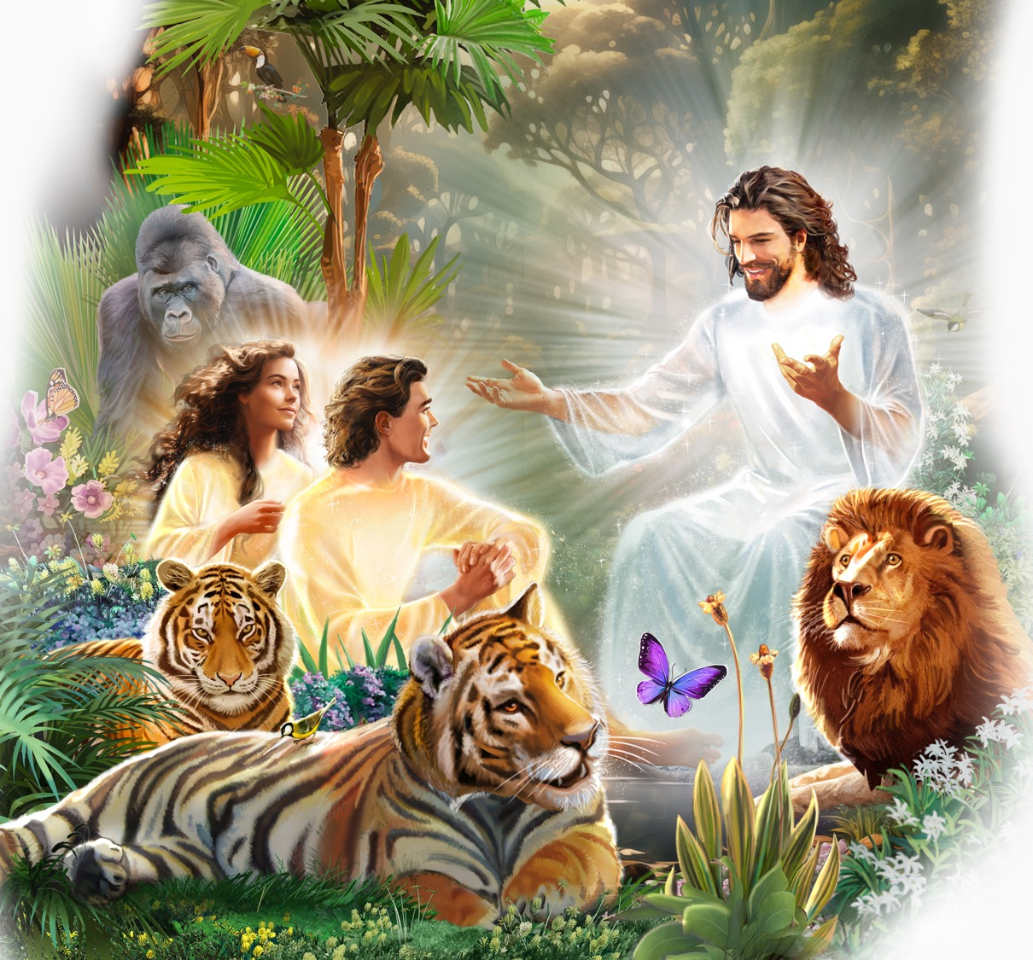

Slide 23
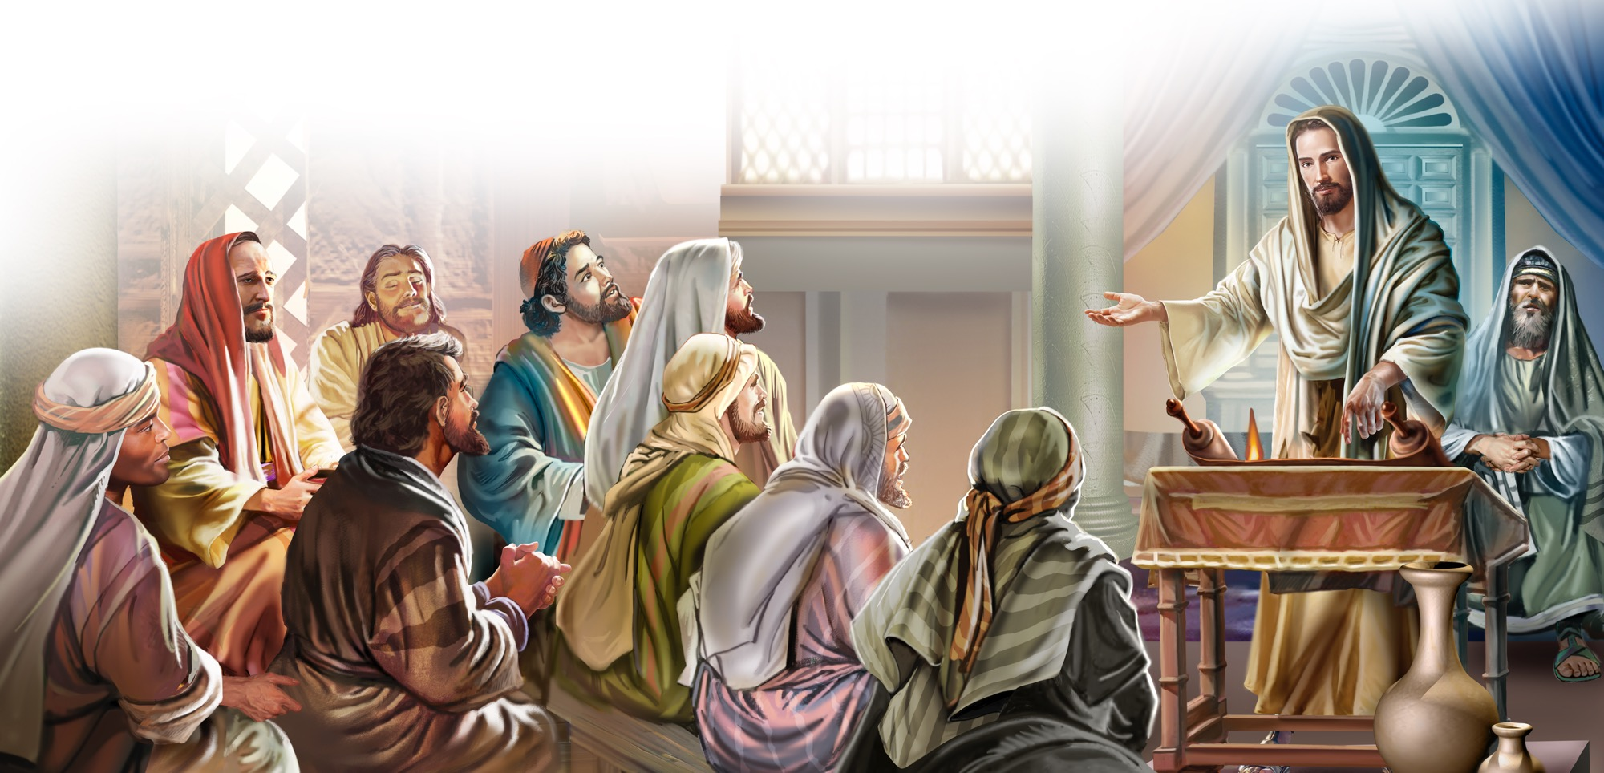

Slide 24


Slide 25
UNPACK
THE
STORY

Slide 26
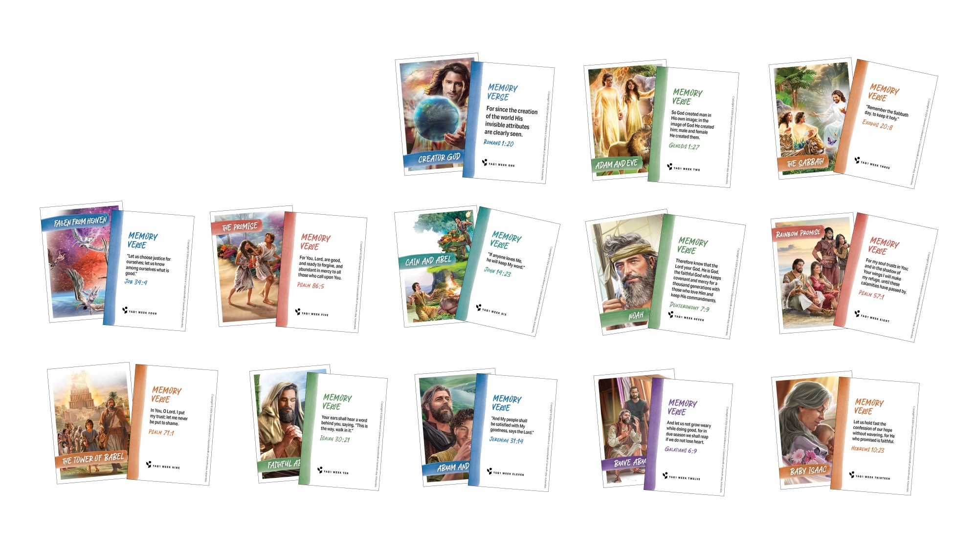
CHARACTER CARDS

Slide 27
MEMORY VERSE
Remember
the Sabbath day,
to keep it holy.
Exodus 20:8

Slide 28
MEMORY VERSE
Remember the Sabbath day,
To keep it holy.
Six days you shall labor
And do all our work,
But the seventh day is the Sabbath
Of the Lord, Your God.
In it you shall do no work,
You nor your son, nor your daughter,
Nor your male servant,
Nor your female servant,
(Continued on next slide.)

Slide 29
MEMORY VERSE
Nor your cattle, nor your stranger,
who is within your gates.
For in six days the Lord made
The heavens and the earth,
The sea, and all that is in them,
And rested the seventh day.
Therefore, the Lord blessed
The Sabbath day and hallowed it.
Exodus 20 verses 8 to11.
“Exodus 20:8-11” by Rosie Smith. Copyright © 2025 General Conference Corporation® of Seventh-day Adventists.

Slide 30
MEMORY VERSE
Remember
the Sabbath day,
to keep it holy.
Exodus 20:8

Slide 31

MISSION
STORY

Slide 32

MISSION
CHALLENGE

Slide 33
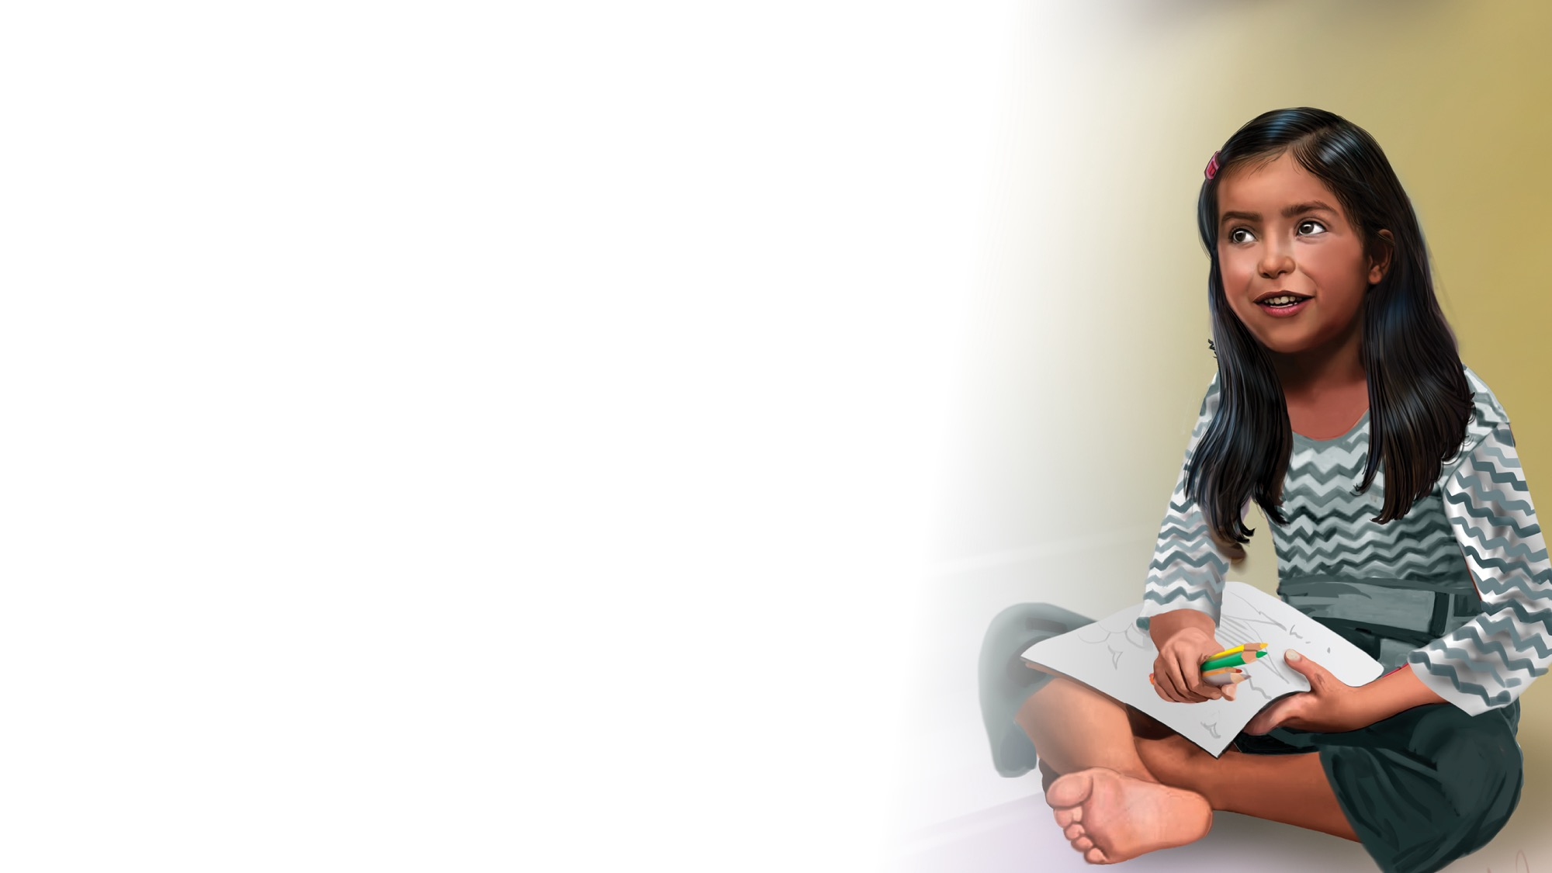
CRAFT

Slide 34
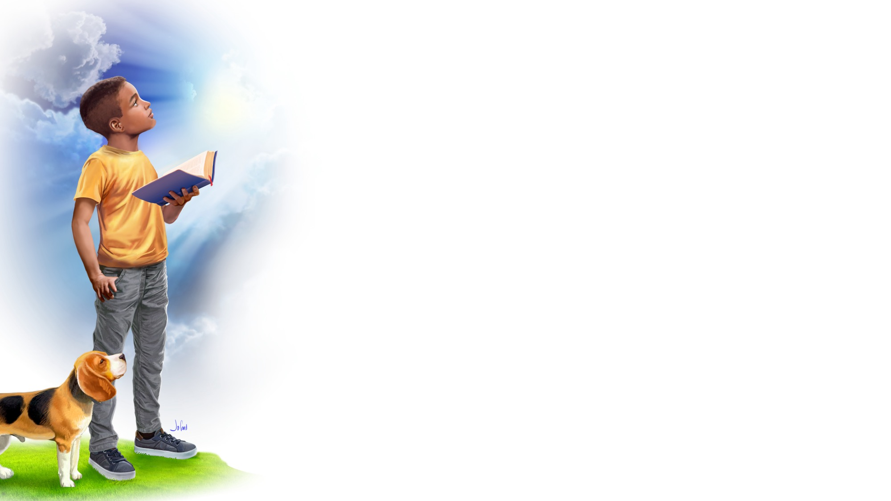
God Bless You
CLOSING SONG
What did you enjoy today?
What did you learn that’s new?
It’s time for us to say:
“Goodbye, and see you soon!”
What did you enjoy today?
What did you learn that’s new?
It’s time for us to say:
“Goodbye, and see you soon!”
(Continued on next slide.)

Slide 35
God Bless You
CLOSING SONG
We’ll see you again,
So until then,
God bless you.
We’ll see you again,
So until then,
God bless you.
God bless YOU!
“God Bless You” by Rosie Smith. Copyright © 2025 General Conference Corporation® of Seventh-day Adventists.

Slide 36
Respond

Slide 37
PRAYER
PRAYER

